Slide 1
Unit 2

Slide 2
Functions & FUNCTION HOISTING

Slide 3
JavaScript Functions
A function is a block of code that executes tasks in a specific order
function functionName (parameters) {
// Do stuff here
}
function is a keyword that tells JavaScript you’re defining a function.
functionName is the name of the function.
parameters is a comma-separated list of variables you wish to declare for your function. They can be assigned values when you use the function. Parameters are optional.
If you declared a parameter, but did not pass a argument to it, your parameter would be undefined .
Rules for naming functions
It must be one word
It must consist only of letters & numbers or underscores
It cannot begin with a number
It cannot be any of the reserved keywords

Slide 4
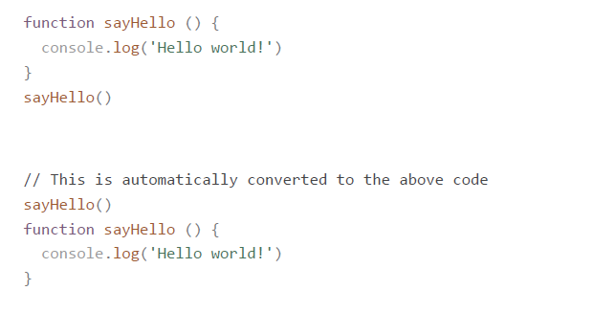
Function hoisting
When functions are declared with a function declaration (as shown above), they are hoisted to the top of your scope.
This means the following two sets of code are exactly the same.
Function hoisting gets confusing because JavaScript changes the order of code. It is
highly recommended that you declare your functions before you use them. Don’t rely on
hoisting.

Slide 5
Declaring functions with function expressions
A second way to declare functions is with a function expression. Here, you declare a
variable, then assign a function without a name (an anonymous function) to it.
const sayHello = function () {
console.log('This is declared with a function expression!’)
}
Note: Functions declared with function expressions are not automatically hoisted to the top of your scope.

Slide 6
variables – scope & hoisting

Slide 7
Understanding Variables
A variable is a named container used for storing values.
A piece of information that we might reference multiple times can be stored in a variable for later use or modification.
In JavaScript, the value contained inside a variable can be any JavaScript data type, including a number, string, or object.

Slide 8
THE VAR KEYWORD
The var keyword can be used to declare a variable, and assign a value to it.
// Assign the string value Sammy to the username identifier
var username = "sammy_shark";
This statement consists of a few parts:
The declaration of a variable using the var keyword
The variable name (or identifier), username
The assignment operation, represented by the = syntax
The value being assigned, "sammy_shark"

Slide 9
NAMING VARIABLES
Variable names can consist only of letters ( a-z ), numbers ( 0-9 ), dollar sign symbols ( $ ),
and underscores ( _ )
Variable names cannot contain any whitespace characters (tabs or spaces)
Numbers cannot begin the name of any variable
There are several reserved keywords which cannot be used as the name of a variable
Variable names are case sensitive

Slide 10
Variable scope
Global variables are those declared outside of a block
Local variables are those declared inside of a block
Variables declared with the var keyword are always function-scoped, meaning they recognize functions as having a separate scope. This locally-scoped variable is therefore not accessible from the global scope.
Variables declared with the var keyword are not block-scoped
// Initialize a global variable
var species = "human";
function transform() {
// Initialize a local, function-scoped variable
var species = "werewolf";
console.log(species);
}

Slide 11
LET & CONST
The keywords let and const , however, are block-scoped.
This means that a new, local scope is created from any kind of block, including function blocks, if statements, and for and while loops.
var fullMoon = true;
// Initialize a global variable
let species = "human";
if (fullMoon) {
// Initialize a block-scoped variable
let species = "werewolf";
}

Slide 12
hoisting
If we attempt to use a variable before it has been declared and initialized, it will return undefined.
Hoisting, a behavior of JavaScript in which variable and function declarations are moved to the top of their scope.
let and const are block-scoped, they will not hoist
Example
// The code we write
console.log(x);
var x = 100;
// How JavaScript interprets it
var x;
console.log(x); // x is undefined
x = 100;

Slide 13
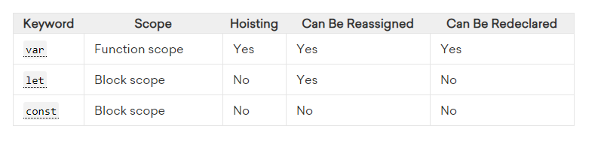
VAR, LET & CONST
Variables introduced with var have the potential of being affected by hoisting, a mechanism in JavaScript in which variable declarations are saved to memory. This may result in undefined variables in one’s code. The introduction of let and const resolves this issue by throwing an error when attempting to use a variable before declaring it or attempting to declare a variable more than once.

Slide 14
JS Objects

Slide 15
The Math Object
Provides a collection of properties and methods useful for Number values
This includes the trigonometric functions such as sin and cos
When used, the methods must be qualified, as in Math.sin(x)

Slide 16
The Number Object
Properties
MAX_VALUE
MIN_VALUE
NaN
POSITIVE_INFINITY
NEGATIVE_INFINITY
Operations resulting in errors return NaN
Use isNaN(a) to test if a is NaN
toString method converts a number to string

Slide 17
String Properties and Methods
One property: length
Note to Java programmers, this is not a method!
Character positions in strings begin at index 0

Slide 18
String Methods
Method | Parameters | Result
charAt | A number | Returns the character in the String object that is at the specified position
indexOf | One-character string | Returns the position in the String object of the parameter
substring | Two numbers | Returns the substring of the String object from the first parameter position to the second
toLowerCase | None | Converts any uppercase letters in the string to lowercase
toUpperCase | None | Converts any lowercase letters in the string to uppercase

Slide 19
The typeof Operator
Returns “number” or “string” or “boolean” for primitive types
Returns “object” for an object or null
Two syntactic forms
typeof x
typeof(x)

Slide 20
The Date Object
A Date object represents a time stamp, that is, a point in time
A Date object is created with the new operator
var now= new Date();
This creates a Date object for the time at which it was created

Slide 21
The Date Object: Methods
toLocaleString | A string of the Date information
getDate | The day of the month
getMonth | The month of the year, as a number in the range of 0 to 11
getDay | The day of the week, as a number in the range of 0 to 6
getFullYear | The year
getTime | The number of milliseconds since January 1, 1970
getHours | The number of the hour, as a number in the range of 0 to 23
getMinutes | The number of the minute, as a number in the range of 0 to 59
getSeconds | The number of the second, as a number in the range of 0 to 59
getMilliseconds | The number of the millisecond, as a number in the range of 0 to 999

Slide 22
Arrays
Arrays are lists of elements indexed by a numerical value
Array indexes in JavaScript begin at 0
Arrays can be modified in size even after they have been created

Slide 23
Array Object Creation
Arrays can be created using the new Array method
new Array with one parameter creates an empty array of the specified number of elements
new Array(10)
new Array with two or more parameters creates an array with the specified parameters as elements
new Array(10, 20)
Literal arrays can be specified using square brackets to include a list of elements
var alist = [1, “ii”, “gamma”, “4”];
Elements of an array do not have to be of the same type

Slide 24
Characteristics of Array Objects
The length of an array is one more than the highest index to which a value has been assigned or the initial size (using Array with one argument), whichever is larger
Assignment to an index greater than or equal to the current length simply increases the length of the array
Only assigned elements of an array occupy space
Suppose an array were created using new Array(200)
Suppose only elements 150 through 174 were assigned values
Only the 25 assigned elements would be allocated storage, the other 175 would not be allocated storage

Slide 25
Array Methods
join
reverse
sort
concat
slice

Slide 26
Dynamic List Operations
push
Add to the end
pop
Remove from the end
shift
Remove from the front
unshift
Add to the front

Slide 27
Two-dimensional Arrays
A two-dimensional array in JavaScript is an array of arrays
This need not even be rectangular shaped: different rows could have different length

Slide 28
JS Objects

Slide 29
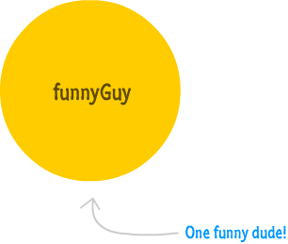
THE Object
the Object type that lays the groundwork for both custom objects as well as built-in types like Function, Array
everything except null and undefined are directly related to an Object or can become one as needed.
Creating Objects
var funnyGuy = {};

Slide 30
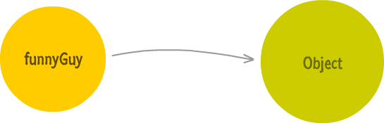
BEHIND THE SCENES
Because ‘funnyGuy’ is an object, is has a connection to the main Object type that it derives from

Slide 31
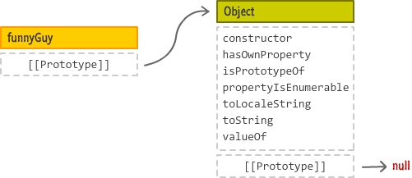
Delving deeper….
funnyGuy object has no properties defined except a special internal property that exists called __proto__ and often represented as [[Prototype]]
This [[Prototype]] property points to our Object

Slide 32
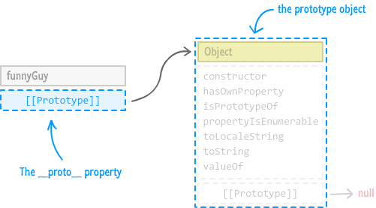
…AND DEEPER
The [[Prototype]] property references is what is known as a prototype object (equivalent to the parent object/super class for OO folks out there)
Example
var funnyGuy = {};
funnyGuy.toString(); // [object Object]

Slide 33
Prototype chain
Prototype Chain. If an object doesn't have what you are looking for, the JavaScript engine will navigate to the next object as determined by the [[Prototype]] property and keep going until it reaches the very end. The very end is when you try to access the [[Prototype]]property on the Object itself. You can't go any further beyond Object, since that is as basic of a type as you can get.

Slide 34
ADDING PROPERTIES TO OBJECTS
Dot notataion
Square bracket syntax
Object initializer with literal notation

Slide 35
ADDING METHODS TO OBJECTS – AN EXAMPLE
var funnyGuy = {
firstName: "Conan",
lastName: "O'Brien",
getName: function() {
return "Name is: " + this.firstName + " " + this.lastName;
}
};
alert(funnyGuy.getName()); // displays "Name is Conan O'Brien"

Slide 36
Window and Document
The Window object represents the window in which the document containing the script is being displayed
The Document object represents the document being displayed using DOM
Window has two properties
window refers to the Window object itself
document refers to the Document object
The Window object is the default object for JavaScript, so properties and methods of the Window object may be used without qualifying with the class name

Slide 37
Screen Output and Keyboard Input

Slide 38
Screen Output and Keyboard Input
Standard output for JavaScript embedded in a browser is the window displaying the page in which the JavaScript is embedded
The write method of the Document object write its parameters to the browser window
The output is interpreted as HTML by the browser
If a line break is needed in the output, interpolate <br/> into the output

Slide 39
The alert Method
The alert method opens a dialog box with a message
The output of the alert is not XHTML, so use new lines rather than <br/>
alert("The sum is:" + sum + "\n");

Slide 40
The confirm Method
The confirm methods displays a message provided as a parameter
The confirm dialog has two buttons: OK and Cancel
If the user presses OK, true is returned by the method
If the user presses Cancel, false is returned
var question =
confirm("Do you want to continue this download?");

Slide 41
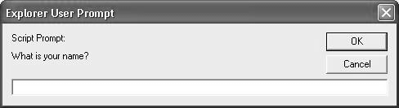
The prompt Method
This method displays its string argument in a dialog box
A second argument provides a default content for the user entry area
The dialog box has an area for the user to enter text
The method returns a String with the text entered by the user
name = prompt("What is your name?", "");

Slide 42
ACCESSING & MODIFYING DOM

Slide 43
HTML,CSS & JavaScript
Your Browser =HTML + CSS + JavaScript
HTML Defines the Structure
CSS defines aesthetic and layout appeal
JavaScript provides interactivity

Slide 44

What is interactive

Slide 45
DOM
Document Object Model
a hierarchical structure that your browser uses to make sense of everything on a webpage
DOM is made up of nodes
Nodes consist of
elements
attributes,
text content,
comments,
document-related stuff,
Every HTML element you want to access has a particular type associated with it, and all of these types extend from the Node base that make up all nodes:

Slide 46
JavaScript & DOM
Changes made to the DOM via JavaScript is reflected in what gets shown in the browser
Using JavaScript you can
dynamically add elements
remove them
move them around
modify attributes on them
set CSS styles
A fully functioning webpage can be made using only JavaScript

Slide 47
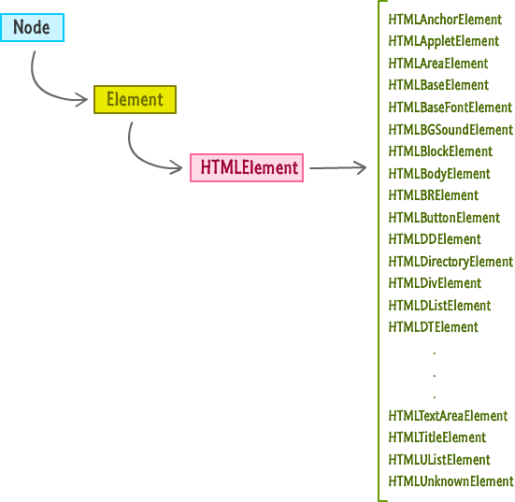

Slide 48
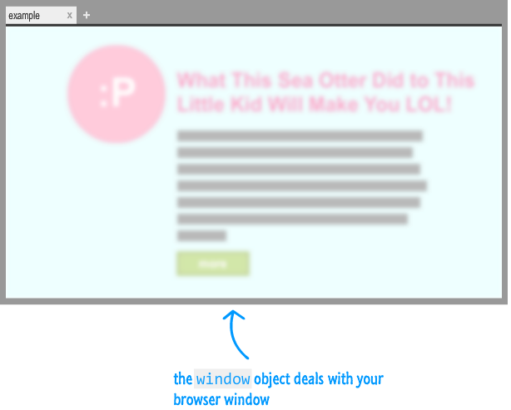
The Window Object
A global object that contains many properties and methods that help to work with a browser

Slide 49
The Document Object
The document object is the gateway to all the HTML elements on a webpage
Document object is not a read-only version of the HTML document.
It is used to read as well as manipulate HTML documents at will.

Slide 50
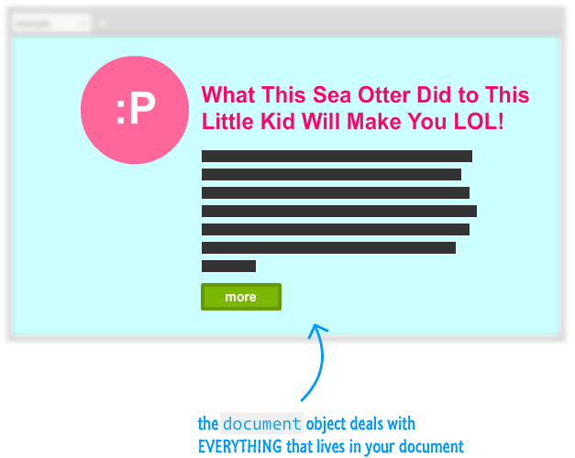
The Document Object

Slide 51
<!DOCTYPE html>
<html>
<head>
<meta content="sea otter, kid, stuff" name="keywords">
<meta content="Sometimes, sea otters are awesome!" name="description">
<title>LOL! Sea Otter! Little Kid!</title>
<link href="foo.css" rel="stylesheet"/>
</head>
<body>
<div id="container">
<img src="seaOtter.png"/>
<h1>The Sea Otter Did to This Little Kid Will Make You LOL!</h1>
<p class="bodyText">
Nulla tristique, justo eget semper viverra, massa arcu hendrerit at semper sed, feugiat a nisi.
<p>
<div class="submitButton">
next
</div>
</div>
<script src="stuff.js"></script>
</body>
</html>

Slide 52
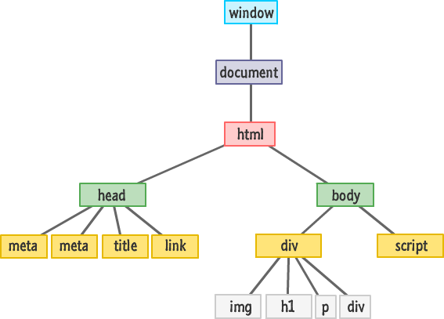

Slide 53
Querying the DOM
document.getElementById
document/node.getElementsByTagName
document.getElementsByName
document/node.getElementsByClassName
querySelector
querySelectorAll

Slide 54
document.getElementById
<body>
<div id="info">Info</div>
<script>
var div = document.getElementById('info')
alert( div.innerHTML )
</script>
</body>
Return a single element (node) with certain id.
If no element is found, null is returned.

Slide 55
querySelector
var element = document.querySelector("< CSS selector >");
querySelector function takes a CSS selector as argument.
Returns the first element it finds that matches the selector
var element = document.querySelector("#main");
var element = document.querySelector(".pictureContainer");

Slide 56
DEMO
<div id="main">
<div class="pictureContainer">
<img class="theimage" src="smiley.png" height="300" width="150"/>
</div>
<div class="pictureContainer">
<img class="theimage" src="tongue.png" height="300" width="150"/>
</div>
<div class="pictureContainer">
<img class="theimage" src="meh.png" height="300" width="150"/>
</div>
<div class="pictureContainer">
<img class="theimage" src="sad.png" height="300" width="150"/>
</div>
</div>

Slide 57
querySelectorAll
var elements = document.querySelectorAll("< CSS selector >");
Returns an array of elements!
var images = document.querySelectorAll(".theimage");
for (var i = 0; i < images.length; i++) {
var image = images[i];
alert(image.getAttribute(src));
}

Slide 58
querySelectorAll
var images = document.querySelectorAll("img");

Slide 59
Caution!!
Not all pseudo-class selectors are allowed. A selector made up of :visited or :link is ignored and no elements are found.
How crazy you can go with the selectors you provide depends on the browser's CSS support. Internet Explorer 8 supports querySelectorand querySelectorAll. It doesn't support CSS3. Given that situation, using anything more recent than the selectors defined in CSS 2 will not work when used with querySelector and querySelectorAll on IE8.
The selector you specify only applies to the descendants of the starting element you are beginning your search from. The starting element itself is not included.

Slide 60
Modifying the DOM
Every HTML tag, style rule, and other things that go into your page has a corresponding representation in the DOM.
HTML elements are so versatile when viewed via the DOM is because they share a lot of similarities with JavaScript Objects.

Slide 61
A simple example!!!
<html>
<head>
<title>Hello...</title>
<style>
.highlight {
font-family: "Arial";
padding: 30px;}
.summer {
font-size: 64px;
color: #0099FF; }
</style>
</head>
<body>
<h1 id="theTitle" class="highlight summer">
What'shappening?</h1>
<script>
</script>
</body>

Slide 62
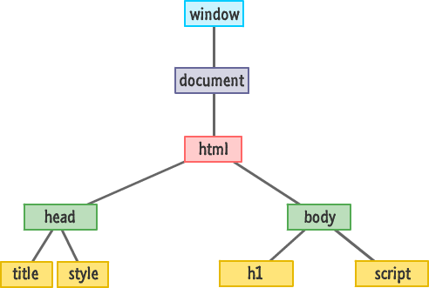

Slide 63
Modify the text
<body>
<h1 id="theTitle" class="highlight summer">What's happening?</h1>
<script>
var title = document.querySelector("#theTitle");
title.textContent = “Nothing going on";
</script>
</body>

Slide 64
getAttribute
<body>
<h1 id="theTitle" class="highlight summer">What's happening?</h1>
<script>
var title = document.querySelector("h1");
alert(title.getAttribute("id"));
</script>
</body>
To retrieve the value of an attribute on the element
returns the value associated with that attribute
if an attribute name doesn't exist, it returns null

Slide 65
setAttribute
<body>
<h1 id="theTitle" class="highlight summer">What's happening?</h1>
<script>
var a=document.getElementById( “theTitle”)
a.setAttibute(“class” ,”foo”)
</script>
</body>
To set the value of an attribute of the element

Slide 66
className
<body>
<h1 id="theTitle" class="highlight summer">What's happening?</h1>
<script>
var title = document.querySelector("h1");
alert(title.id);
title.className = "bar foo";
</script>
</body>
To retrieve the class of any element

Slide 67
Setting Styles
var myElement = document.querySelector("#superman");
myElement.style.backgroundColor ="#D93600";
Every HTML element that you access via JavaScript has a style object.
This object allows you to specify a CSS property and set its value

Slide 68
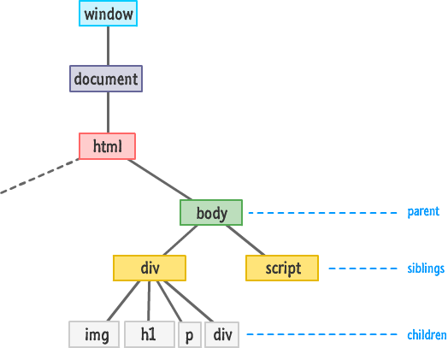
Traversing the DOM

Slide 69
Meet The Family!!
firstChild
lastChild
parentNode
children
previousSibling
nextSibling

Slide 70
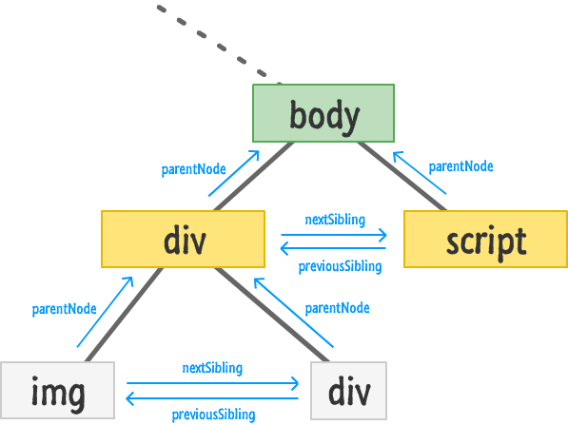

Slide 71
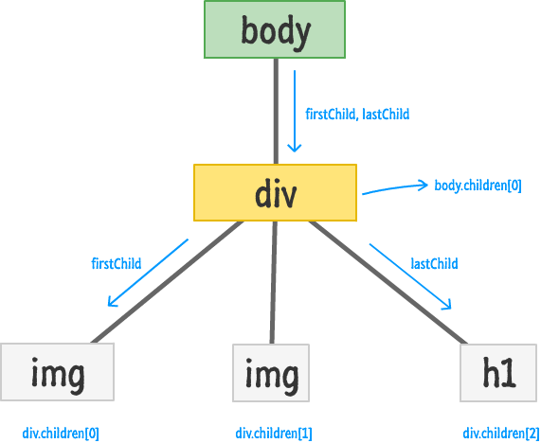

Slide 72
Checking If A Child Exists
var bodyElement = document.body;
if (bodyElement.firstChild) {
// do something interesting
}
If statement will return null if there are no children
Can also be used with
bodyElement.lastChild
bodyElement.children.length

Slide 73
Accessing All the Child Elements
var bodyElement = document.body;
for (var i = 0; i < bodyElement.children.length; i++) {
var childElement = bodyElement.children[i];
alert(childElement.tagName);
}

Slide 74
Creating Elements
document.createElement("p");
To create a new element on a page
Call the createElement method through the document object
Pass the tag name of the object to be created

Slide 75
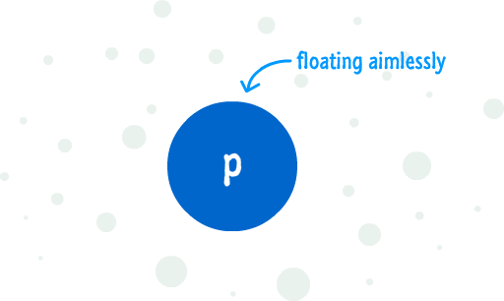
To add it to the DOM
Find an element that will act as the parent
Use appendChild and add the newly created element to the parent element

Slide 76
<body>
<h1 id="theTitle" class="highlight summer">What's happening?</h1>
<script>
var newElement = document.createElement("p");
newElement.textContent = "I exist entirely in your imagination.";
document.body.appendChild(newElement);
</script>
</body>

Slide 77
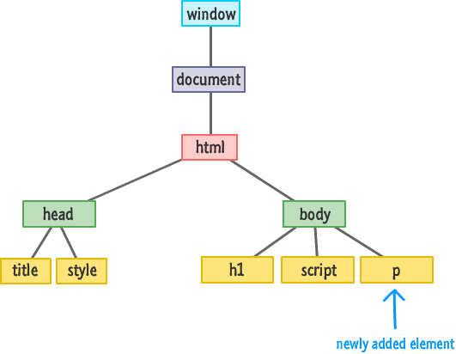
The DOM after appending

Slide 78
insertBefore
<body>
<h1 id="theTitle" class="highlight summer">What's happening?</h1>
<script>
var newElement = document.createElement("p");
newElement.textContent = "I exist entirely in your imagination.";
var scriptElement = document.querySelector("script");
document.body.insertBefore(newElement, scriptElement);
</script>
</body>
The insertBefore function takes two arguments.
The first argument is the element you want to insert.
The second argument is a reference to the sibling you want to precede.

Slide 79
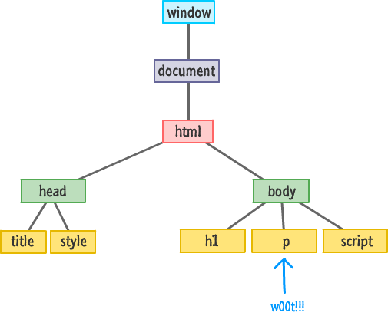

Slide 80
Removing Elements
<body>
<h1 id="theTitle" class="highlight summer">What's happening?</h1>
<script>
var newElement = document.createElement("p");
newElement.textContent = "I exist entirely in your imagination.";
document.body.appendChild(newElement);
document.body.removeChild(newElement);
</script>
</body>

